Slide 1
Trainers Manual
VET & SME Tourism Crisis Curriculum

Slide 2
01
Introduction to THE NAVIGATING TOURISM CRISIS RECOVERY PROJECT
02
Our resources at a glance
03
Welcome to OUR VET & SME
Tourism Crisis Curriculum
04
Course Overview
CONTENT
05
Teaching Methods
www.tourismrecovery.eu

Slide 3
Introduction to THE NAVIGATING TOURISM CRISIS RECOVERY PROJECT
“Deep within every crisis is an opportunity for something beautiful.”
Kate McGahan
Due to its characteristics, the tourism industry is particularly vulnerable to crises. T-CRISIS-NAV will help to educate existing small and medium-sized enterprises (SMEs) and future entrepreneurs in the tourism sector to gain the skills and tools needed to successfully navigate their business through a virulent crisis. They will be fully equipped with the knowledge and actionable tools to analyse the specific extent of crisis impact and develop suitable countermeasures and navigate their company safely through the crisis.
In order to achieve a sustainable effect, we focus not only on higher education institutions (HEI) but also on SMEs and vocational education and training (VET) tourism networks and the areas that educate and train future managers, employees and entrepreneurs in the tourism sector. As tourism industry is characterised by an above-average proportion of SMEs, and as these are at the same time particularly vulnerable but also innovative, our work has an effect not only in terms of securing jobs but also on the innovative strength of the entire industry. This is especially true regarding sustainable tourism approaches.
This project builds on our existing knowledge with regard to crisis management, turnaround, curricula development and innovative learning content design and fills existing research gaps with regard to crisis management and needs of SMEs in the tourism sector. Building on this, we developed an up-to-date HEI curriculum, an actionable VET-Training package, a set of open educational resources addressing SMEs and startups and an innovative learning app: all helping to put existing and future owner/ managers in tourism SMEs to gain the knowledge and management competencies to navigate their company through the virulent crisis and to become more crises resilient in the future.

Slide 4
Our resources
at a glance
Please peruse the comprehensive range of meticulously curated resources that have been cultivated through the course of this project. Promote awareness among learners about these resources, as they significantly contribute to enriching the overall learning encounter.
International Needs Analysis On Tourism Crisis Management For SMEs
This resource encompasses preliminary research conducted by the T-CRISIS-NAV project partners to comprehend tourism landscape risks, crisis impacts on European SMEs and regions, identify gaps, and offer recommendations for enhancing preparedness, response, and resilience.
VET & SME Tourism Crisis Curriculum
The training course enables owners and managers of tourism SMEs to detect and prepare for a potential business crisis and teaches specific measures to cope with a business crisis and build up crisis resilience.
HEI Regional Tourism Crisis Curriculum
This course aims to equip HEI (Higher Education) educators and students with an essential methodical approach to regional tourism crisis management.
Navigating Tourism in Crisis App
Our Navigating Tourism in Crisis App is aimed directly at new and existing entrepreneurs who are interested in thriving within the challenging tourism sector, especially during turbulent crises. Our innovative and highly engaging app aims to educate SMEs, future entrepreneurs, and those in higher education institutions in a non-traditional, on-the-go setting.
You are here

Slide 5
Welcome to OUR VET & SME
Tourism Crisis Curriculum
What is the purpose of these materials?
Small and medium-sized enterprises in the tourism industry are especially at risk of business crises – they lack the resources and/or the operational as well as strategic know-how to navigate their business through difficult times.
However, the topic of business crisis is highly complex, touching all areas of entrepreneurial competencies. In fact, overcoming a business crisis is one of the most difficult management tasks of all. There is no easy workaround on the topic.
Based on many years of practical experience in crisis consultancy, we developed a comprehensive training course enabling owners/managers of tourism SMEs to
detect and prepare for a potential business crisis,
teach specific measures to cope with a business crisis and
build up crisis resilience.
Who is the training course for?
Our training course is aimed at owners and managers of SMEs operating in the tourism sector and already have business management knowledge.
What is to be considered?
Due to the complexity of the topic, it will take some time and concentration to complete the training course. Nonetheless, we strongly recommend to invest the time to acquire the knowledge needed to mitigate a business crisis. After all, it is an investment in the survival of your business.

Slide 6
Course Overview
Module 1
Module 2
Introduction to Business Crises in Tourism SMEs
Precaution & Avoidance of Crises
Module 3
Module 4
Coping with Crises
Liquidity Crisis &
Liquidity Management
Module 5
Module 6
Functional Competences
Adaptive Leadership
Module 7
Crisis Resilience

Slide 7
CLICK TO
GET TO THE COURSE
Here you download the complete
VET & SME tourism crisis training package.

Slide 8
Introduction to our case studies
In our training course, we have included a selection of case studies for each module, blending both real-world and fictional scenarios. These case studies adhere to a consistent framework and can be employed as effective tools to stimulate analytical thinking and collaborative solution development throughout the course.
The structure is as follows:
Initial Situation
Each case study initiates with a presentation of the company's initial circumstances, offering context for the subsequent exploration.
Special challenges and problems faced by the company
Following this, we delve into the specific problem, elucidating the distinctive challenges and complexities faced by the company.
Group Discussion / Exercise
A practical task follows, designed to foster group discussions. This segment encourages participants to collectively brainstorm potential solutions to the presented problem.
Approach
A plausible approach and solution are then provided, serving as a valuable resource for your preparation and offering a reference point to enrich the ensuing discussion. This suggested solution provides learners with an opportunity to deepen their understanding of the issue.
Consider organizing a feedback session as post-exercise. This allows participants to reflect on their problem-solving approaches and extract insightful takeaways from the experience.

Slide 9
Case Studies
As outlined in the previous section, we have compiled case studies for each module, through which learners gain insight into various problems and challenges faced by European tourism SMEs.
Legend
Through the utilization of the following symbols in this trainer's manual, our intention is to simplify and expedite your navigation within the corresponding module overview.
Exercises
Within each module, you will encounter a range of exercises designed to enhance the learning experience. These exercises encompass various task types, spanning from brainstorming and interactive discussions to hands-on practical assignments, all seamlessly integrated into the modules.
Test & Practice Questions
The test and practice questions serve to consolidate and assess the acquired knowledge, fostering a deeper understanding of the material. In our Navigating Tourism in Crisis App, you will find more questions to be possibly included in your lessons.
Recommended Reading
Exploring our recommended literature enhances your lesson preparation by providing diverse perspectives and in-depth insights on the subject matter. These recommendations serve as valuable resources for developing a comprehensive understanding of the topic. They also provide opportunities to expose the learners to a broader range of concepts and viewpoints, promoting a more intensive and comprehensive learning process.

Slide 10
Module 1:
Introduction
Click to download
Topics covered:
What is a company crisis? Some basic knowledge
Company Crises in Tourism SMEs
Tools that help to analyse your starting position
Outlook on the topics covered in this course
Learning Outcomes
…Explore what defines a business crisis and how to distinguish the term from others
…Deepen your understanding of what makes a business crisis so complicated and what the typical course is
…Discover why the tourism industry is particularly vulnerable to crises
…Gain an overview of the different reasons that can cause a crisis in a tourism SME
…Understand the need for tourism SMEs in particular to deal comprehensively with the issue of crisis management

Slide 11
Module 1:
Introduction
Exercises
Causes of crises in Tourism SMEs (Slide 22):
Finding examples for exogenous and endogenous causes
Discussion & Exchange (Slide 24):
What kind of crisis do you think you are most likely to be threatened by?
Would you be prepared for it?
SWOT analysis (Slide 27):
Carrying out a SWOT analysis for own company
PESTEL analysis (Slide 36):
Thinking about influencing factors for own company, their impact and possible actions that can be derived from this
Test & Practice Questions
Why are tourism SMEs particularly susceptible to corporate crises?
What is the typical course of a corporate crisis?
What do the letters in PESTEL, a framework used in strategic analysis, stand for?

Slide 12
Module 2:
PRECAUTION &
AVOIDANCE OF CRISES
Click to download
Topics covered:
Business Risk Management
Strategy Development
Risk Factors & Early Warning Signs
Continuity Management
Learning Outcomes
… understand what factors lead to a crisis and how to prevent it
... understand the importance of risk management for companies
... know the tools for developing a sound strategy and how to apply them
... recognise and evaluate crisis risk factors for your company at an early stage
...know the principles of business continuity management

Slide 13
Module 2: PRECAUTION
& AVOIDANCE OF CRISES
Case Studies
Case study no. 1 deals with the use of KPIs as early warning indicators for a small boat rental company.
Exercises
Strategy Development (Slide 31):
Creating own strategic plan by following the steps vision, goals, strategies, measures.
Discussion & Exchange (Slide 70):
Can a crisis be avoided?
Test & Practice Questions
What are the most common internal factors that can cause a crisis in SMEs?
Where can information about influencing trends in an industry primarily be found, and what should be done with this information?
Which methods can help to prevent a Crisis in Human Resource Management at an Early Stage?
Recommended Reading
In preparation for the module, we recommend reading the following literature. At the end of the module, you will find further recommendations.
5 SWOT Analysis Examples - Small Business Trends (smallbiztrends.com)
Portfolio Analysis and Investment Review Reduce Risk (thebalancemoney.com)
Accountancy-Europe-SME-risk-management-series-introduction-paper.pdf (accountancyeurope.eu)
5 Steps in a Business Process Management Life cycle – Customer Service Blog from HappyFox

Slide 14
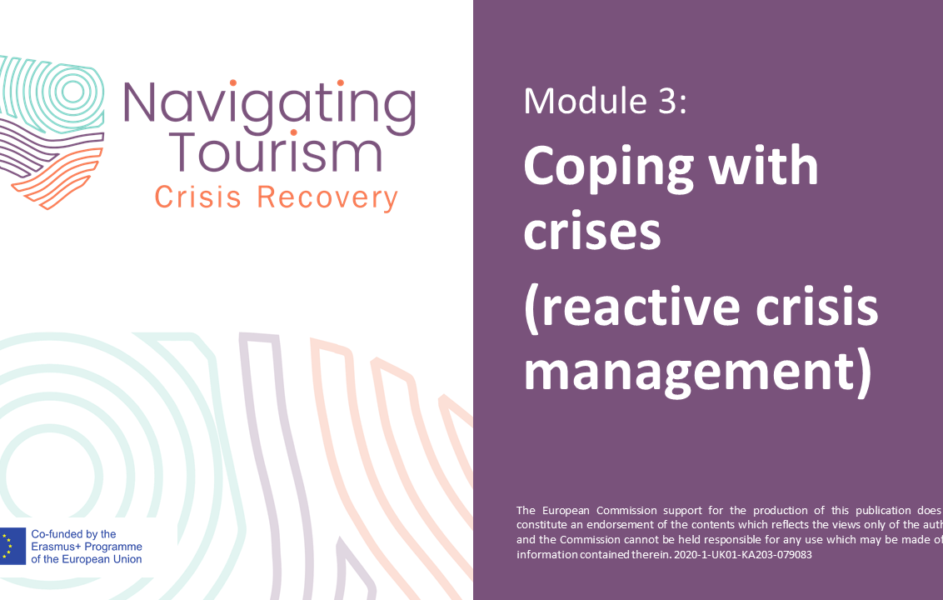
Module 3:
Coping with crises
(reactive crisis management)
Click to download
Topics covered:
Strategic Options in Crisis
Crisis Management Measures
Change processes to cope with a crisis
Strategic Restructuring Concept
Personal Crisis Management
Learning Outcomes
…Develop an understanding that the more advanced the crisis, the fewer options you have
…Learn which crisis management measures are suitable for tourism SMEs
…Know what is important in change processes to overcome a crisis
…Become familiar with the challenges of a restructuring concept
…Understand the importance of learning from failure

Slide 15
Module 3:
Coping with crises
Case Studies
Case study no. 2 and no. 3 show how the innovative adjustment of the current business model can help to get through a business crisis well.
Case study no. 4 shows how a family-owned hostel deals with the development of a new mission and vision.
Case study no. 5 deals with the personal perspective: discuss and learn what affected owners and managers in such situations can do to find purpose and to gain focus.
Exercises
Discussion & Exchange (Slide 38):
What trends are emerging in the tourism industry and will shape the future of the sector? To what extent can and should these be taken into account in tourism SMEs in crisis?
Learning from Failure - Marshmallow Challenge (Slide 55):
Conduct the challenge according to the instructions and reflect afterwards what we can learn from this.
Test & Practice Questions
How does the management of a crisis in Small and Medium Enterprises (SMEs) typically compared to that in larger companies?
What does the acronym RACE, a structured approach to reducing the negative effects of crises, stand for?
What is the primary purpose of a SWOT analysis in strategic planning?

Slide 16
Module 3:
Coping with crises
Recommended Reading
In preparation for the module, we recommend reading the following literature:
Hernández et al. (2021): The Management Practices of Tourism SMEs in Pandemic Times: innovation as a quest of survival.
Henderson (2007): Tourism Crises: Causes, Consequences and Management.
Kukanja et al. (2020): Crisis Management Practices in Tourism SMEs During the Covid-19 Pandemic.
Proactive vs. Reactive Crisis Communication Plans | Ghidotti Communications
Trend: Resonance Tourism (German Source)
The value of failure |Harvard Business Review
Crisis Management Examples: Learn from These 7 Brands | brandfolder.com

Slide 17
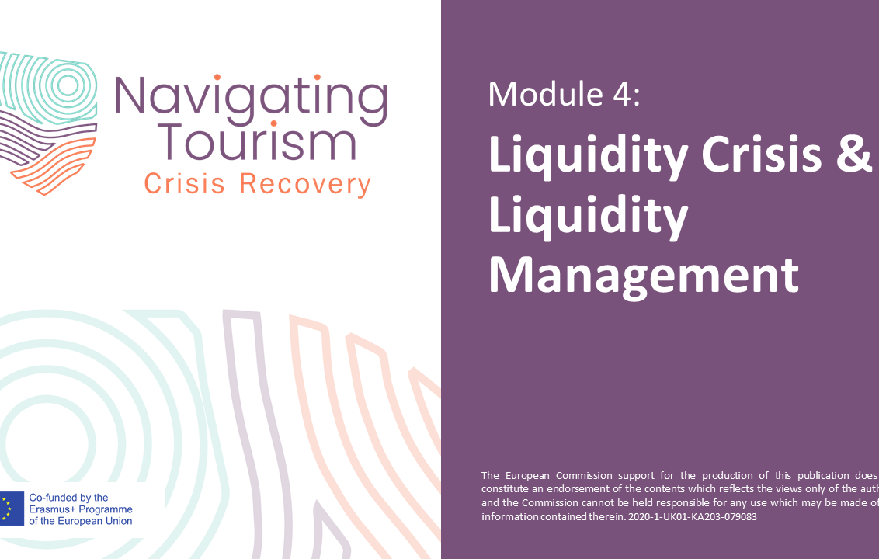
Module 4:
Liquidity Crisis & Liquidity Management
Click to download
Topics covered:
Characteristics of a Liquidity Crisis
Liquidity Planning
Practical Example of Monthly Liquidity Planning
Financial Measures to Overcome the Liquidity Crisis
Key Financial and Liquidity Ratios
Learning Outcomes
… Learn the essential characteristics of a liquidity crisis
… Understand how to reduce the probability of your SME facing insolvency
… Become familiar with the basic structure of liquidity planning
… Know the key financial and liquidity ratios

Slide 18
Module 4: Liquidity Crisis & Liquidity Management
Case Studies
Case study no. 6 shows how a family-run hotel in Germany has implemented the liquidity planning. This will help learners deepen their understanding and learn about the specific challenges.
Exercises
Integrated financial planning (Slide 36 ff.):
Considering the influences of different business transactions on liquidity, the balance sheet and the profit and loss account
Test & Practice Questions
Why is liquidity planning particularly challenging, yet essential in the tourism sector?
What constitutes the basic structure of liquidity planning?
Recommended Reading
In preparation for the module, we recommend reading the following literature:
Liquidity crisis: What happens & how to solve it? | Agicap
This is how good liquidity planning works | finway
A clear path towards short-term liquidity visibility for SMEs (assets.kpmg)
Zwißler et al (2013): Lean and Proactive Liquidity Management for SMEs, Procedia CIRP Vol. 7, P. 604-609 ((PDF) Lean and Proactive Liquidity Management for SMEs (researchgate.net))
Understanding Liquidity Ratios: Types and Their Importance (investopedia.com)
What do SMEs need to consider when applying for a loan? - Accounto | Digitale Buchhaltung
Diez et al (2021): Insolvency Prospects Among Small and Medium Enterprises in Advanced Economies: Assessment and Policy Options, Staff Discussion Notes No. 2021/002( Insolvency Prospects Among Small-and-Medium-Sized Enterprises in Advanced Economies: Assessment and Policy Options (imf.org))

Slide 19
Module 5:
Functional Competences
Click to download
Topics covered:
Management of Operations
Stakeholder Management
Human Resources & Internal Crisis Communication
Communication in Crisis
Importance of Social Media in Crisis
Learning Outcomes
… Be able to sketch and optimise operational processes
… Discover how to identify and assess your stakeholders
… Understand the importance of human resources for the company and be able to guide your staff through crises
… Be trained in crisis communication
… Know how to use social media to the company's advantage, especially in crises

Slide 20
Module 5:
Functional Competences
Case Studies
Case study no. 7 shows how a wine tasting provider uses digital tools in marketing and online sales to manage operations during a crisis.
Case study no. 8 deals with the importance of stakeholder management in crises.
Case study no. 9 approaches the handling of human resources during a crisis using the example of a travel agency.
Test & Practice Questions
What are the five steps to optimize your management of operations
What is the main purpose of stakeholder management in an organization?
What are the main benefits of social media monitoring for a business?
Recommended Reading
In preparation for the module, we recommend reading the following literature:
Civelek et al(2016): The Role of Social Media in Crisis Communication and Crisis Management, International Journal of Research in Business & Social Science, 5(3).
Stephens et al(2005): Communicating with Stakeholders during a Crisis, Journal of Business 42, 4
Wolniak (2019): Operations Manager and its Role in the Enterprise, Production Engineering Archives 24, 1-4.
The ultimate guide to stakeholder management for your marketing projects (filestage.io)
The Role of HR in Crisis Management – Bryghtpath
How to Create a Social Media Crisis Communication Plan | Sprout Social
Ndlela (2018): A Stakeholder Approach to Risk Management, Crisis Communication Vol. 29, S. 53-75.

Slide 21
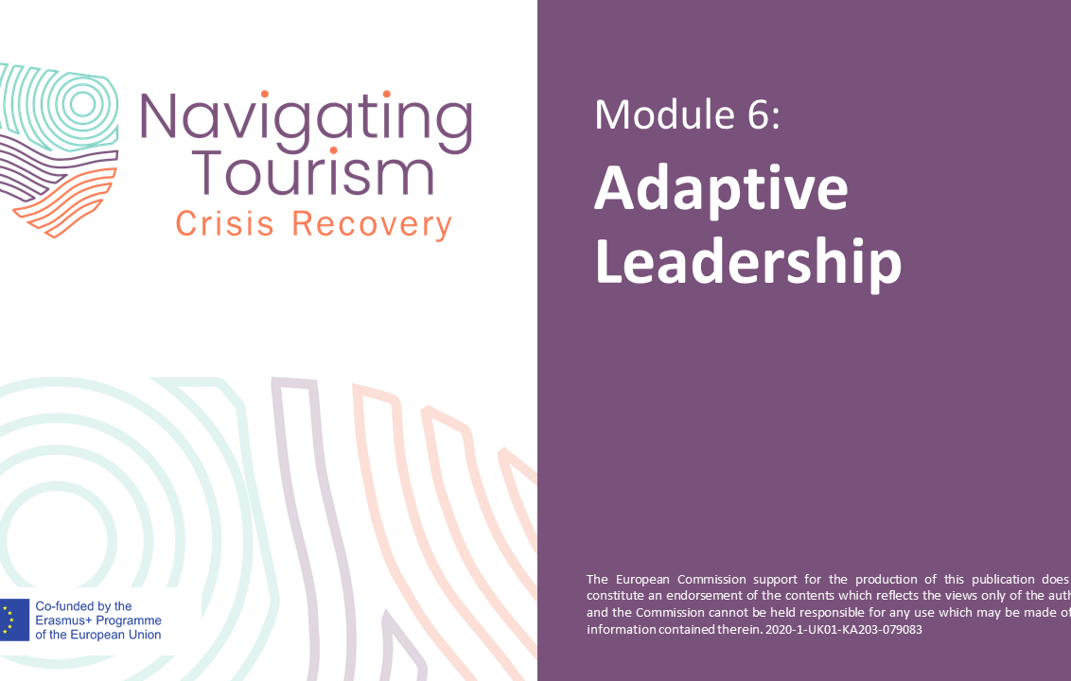
Module 6:
Adaptive Leadership
Click to download
Topics covered:
Characteristics of Leadership (in a Crisis)
Management in a Crisis - Competencies needed
Basics of Leadership in a Crisis
Leadership in a Crisis: The Adaptive Leadership Approach
Five Steps to Adaptive Leadership in a Crisis
Learning Outcomes
… Reflect on your own understanding of leadership (in a crisis)
… Be aware of the key competencies needed to be a successful manager in a crisis
… Be familiar with the key characteristics of leadership in a crisis
… Know the key aspects of adaptive leadership allowing you to respond to the uncertainties of a crisis

Slide 22
Module 6:
Adaptive Leadership
Case Studies
Case study no. 10 demonstrates the holistic leadership approach of Patagonia.
Exercises
Brainstorming: Leadership (Slide 5 ff.):
Brainstorming session to think about leadership, good leadership, skills of good leaders and skills of good leaders in a crisis.
Self-Reflection: Your Leadership Challenge (Slide 40):
With the help of guiding questions, learners have the opportunity for self-reflection.
Test & Practice Questions
How does a crisis typically impact employee performance and behavior, and what is the role of leadership during such times?
What are some of the key roles and actions a leader should adopt in a crisis situation?
What qualities are important for leaders to exhibit during a crisis?
Recommended Reading
In preparation for the module, we recommend reading the following literature:
Heifetz, R. (1994) Leadership Without Easy Answers. Cambridge, Mass: Harvard University Press.
Heifetz, R., Grashow, A. and Linsky, M. (2009) ‘Leadership in a (permanent) crisis’. Harvard Business Review, July/August, https://hbr.org/2009/07/leadership-in-a-permanent-crisis
How to make good decisions in times of crisis (fastcompany.com)
12 business leaders share how they lead their teams through a crisis (msn.com)
Mastering the lessons of crisis management and rapid recovery (themandarin.com.au)
Decision making during the coronavirus crisis | McKinsey
The Art of Making Tough Decisions in a Crisis | Psychology Today

Slide 23
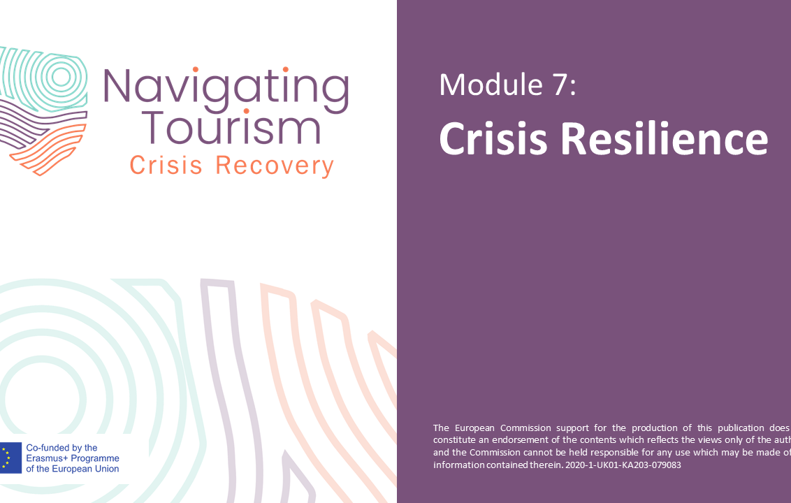
Module 7:
Crisis Resilience
Click to download
Topics covered:
Organisational crisis resilience
Future-oriented tourism offers
Factors influencing resilience
Sustainable tourism development
Learning Outcomes
… Deepen the understanding of resilience
… Grasp what organisational resilience is and what companies can do to achieve it
… Be able to understand and win the guest of the future
… Be familiar with factors that influence resilience in tourism SMEs
… Understand why resilience and sustainability go hand in hand

Slide 24
Module 7:
Crisis Resilience
Case Studies
Case study no. 11 shows how an Icelandic company has responded to the changing environment due to the Corona pandemic.
Case study no. 12 deals with the reduction of the carbon footprint of a hotel and its corporate social responsibility.
Exercises
Group Discussion (Slide 39):
Which business model pattern could suit your company?
How could you make use of it?
Test & Practice Questions
In the context of crisis resilience, what does a "Generative" company do?
According to a German study on the future of travel occasions, what are the top three themes guests are seeking?
Recommended Reading
In preparation for the module, we recommend reading the following literature:
ISO 22316:2017: Security and resilience — Organizational resilience — Principles and attributes: https://www.iso.org/obp/ui#iso:std:iso:22316:ed-1:v1:en
PwC (2018): Operational resilience: https://www.pwc.co.uk/audit-assurance/assets/pdf/operational-resilience-guide.pdf
Breier et al. (2021): The role of business model innovation in the hospitality industry during the COVID-19 crisis .
Hall et al. (2017): Tourism and resilience: Individual, organisational and destination perspectives.
Frey (2020): Der KMU Innovator - So machen Sie Ihr Geschäftsmodell fit für das digitale Zeitalter, Midas Verlag AG.
7 Pillars of Resilience to Master Any Challenge

Slide 25
Teaching Methods I/II
In the realm of education, various methods of instruction have evolved to cater to diverse learning preferences and technological advancements. This course can be conducted through classroom training, online learning, or hybrid learning modes.
Classroom training, also known as traditional or in-person learning, has been a cornerstone of education for generations. This method involves students and instructors gathering in a physical classroom setting. It offers several benefits:
Interpersonal Interaction: Classroom training fosters direct face-to-face interaction between learners and teachers, facilitating immediate clarification of doubts and personalized guidance.
Structured Learning Environment: The structured nature of classroom training encourages discipline and routine, creating a focused learning environment.
Peer Engagement: Learners can engage with peers through group discussions, debates, and collaborative projects, promoting social skills and teamwork.
Real-time Feedback: Instructors can provide instant feedback, enabling learners to grasp concepts more effectively.
Flexibility: Learners can access materials and participate in lessons at their own pace and convenience, allowing for customization to individual schedules.
Diverse Multimedia: Online learning employs various media formats, such as videos, interactive simulations, and quizzes, enhancing engagement and catering to various learning styles.
Global Reach: Online learning transcends geographical barriers, enabling learners to connect with instructors and peers from around Europe/the world.
Self-Directed Learning: This method encourages learners to take responsibility for their learning journey, cultivating self-discipline and time management skills.
Online learning, often referred to as e-learning or digital learning, leverages digital platforms to deliver educational content. Key aspects of online learning include:

Slide 26
Teaching Methods II/II
In the realm of education, various methods of instruction have evolved to cater to diverse learning preferences and technological advancements. This course can be conducted through classroom training, online learning, or hybrid learning modes.
Hybrid learning, also known as blended learning, combines elements of both classroom training and online learning. This approach seeks to harness the benefits of each method:
Flexibility with Structure: Hybrid learning offers a balance between in-person interaction and online convenience, allowing learners to tailor their learning experience.
Personalized Progress: Learners can progress through online modules at their own pace while still benefiting from guided classroom discussions and collaborative projects.
Varied Learning Experiences: Instructors can curate a dynamic learning experience by incorporating diverse resources from both physical and digital realms.
Adaptability: Hybrid learning can easily adapt to evolving circumstances, such as unforeseen events or changes in learning preferences.
In conclusion, the choice of instructional method depends on factors such as individual learning preferences, subject matter, technological infrastructure, and accessibility. Each method offers unique advantages, and educators may choose to integrate multiple approaches to create a well-rounded and effective learning environment. Identify the variant that aligns most effectively with your specific circumstances for conducting our VET & SME Tourism Crisis training course!

Slide 27
We appreciate your use of our T-CRISIS-NAV resources and wish you an enjoyable and successful course implementation!
To find out more, kindly visit our website at https://www.tourismrecovery.eu/
or connect with us on Facebook: https://www.facebook.com/tourismcrisisrecovery
www.tourismrecovery.eu

